Slide 1

First Sprint Iteration
Team: Codeachrome
Members: Donald Dedman, Jeremiah Doody, Timothy Folds, Julio Orozco and John Verdi

Slide 2

World Arts Film Festival

Slide 3

World Arts Film Festival 2015 Fact Sheet
What: World Arts Film Festival, a three-day international short film festival for all ages and all abilities, returns for its third year.
When: Thursday, October 15th; Friday, October 16th; Saturday, October 17th
Theme: Generating greater communication and cultural understanding through film, art and education.
Where: The Conference Center At The Main Library, Jacksonville, FL
Who: This year projected estimate of 5,000 attendees are expected to benefit from participating in the World Arts Film Festival including third grade to college-aged students, local and visiting filmmakers from over 30+ countries, men and women from the Greater Jacksonville area, New York and California, groups, families and individuals of diverse backgrounds including those with special needs interested in the unique film festival experience.
How Much: Tickets to the event start at $10.00 for students and $25.00 for adults attending all day, includes film screenings and breakout sessions with industry speakers, hands-on workshops, daytime receptions and arts exhibits.
Topics: Animation, Documentary, Narrative fiction, Autism, Special Needs, Women Filmmakers, Student Film, Leadership, Positive Youth Development

Slide 4
World Arts Film Festival Project
Ability for audience to cast one vote per hour, therefore the same viewer will be able to vote again on new content. The voting page containing film information needs to change each hour.
A public leader page that lists votes received for films screened previously.
Ability for administrators to manage film sessions that are displayed in the voting screen
Ability to input attendees information (contact and demographics) and generate voting IDs
Ability for administrators to see votes received for each film screened
Ability to archive voting data at the end of festival
Generate visualizations on votes received based on film genre
Voting system should be responsive to both desktop and mobile screens
Mobile App for viewing film sessions and schedule as well viewing info about film makers
Mobile App should provide functionality to vote on films
Mobile App should be provide capability for audience to submit comments for film makers and festival organizers

Slide 5
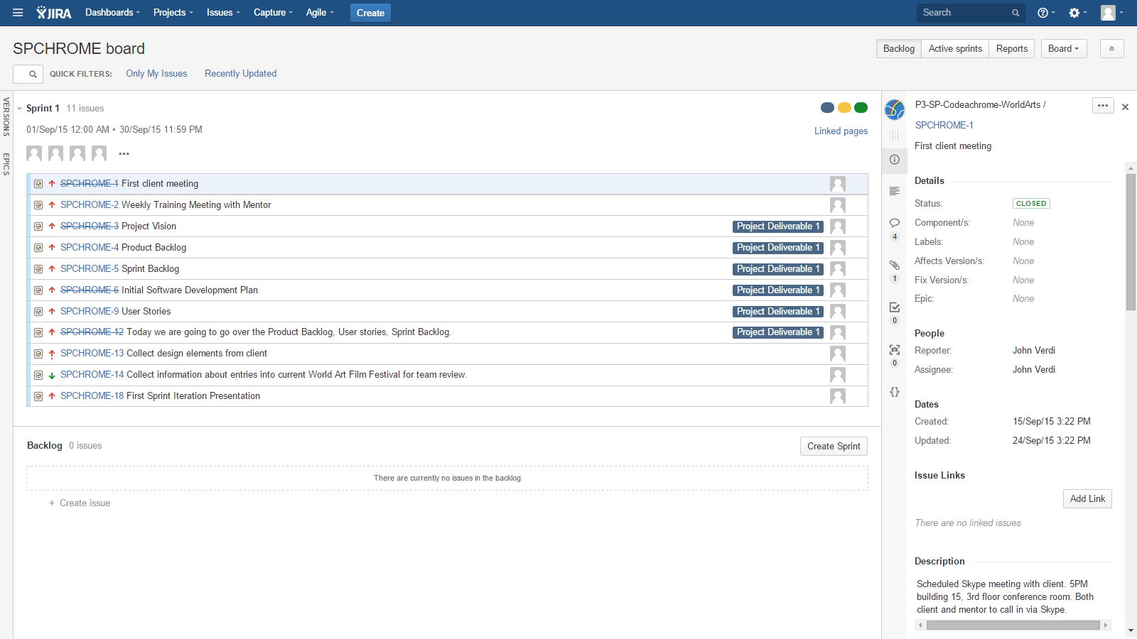
Product Backlog

Slide 6
User Stories
Admin enters film titles into time block
Admin pulls event demographics report
Admin assigns movie genre
As an admin, I want to modify film info so that I can fix any mistakes if made upon inserting information
As an admin, I want to create time blocks so that I can assign films to them
As an admin, I want to view demographic reports so that I can analyze them
Admin
As an admin, I want to insert film info so that I can assign films to time blocks
As an admin, I want to assign films to time blocks so that viewers will know when films will be shown
As an admin, I want to modify time blocks so that any errors made when inserting data can be fixed
As an administrator, I want to get optional user feedback to better understand my voters
As an admin, I want to delete time blocks so that I can get rid of a time block if needed

Slide 7
User Stories
As a voter, I'd like to see a leader board of the voting progress for all films
Voter has single vote per session
As a voter, be able to enter simple demographic info
As a member, I want to login to my Film Festival account
Voter
Non-members need to be able to login as a guest to submit a vote
As a user, I want to be able to download the mobile app as quick as possible so I can vote as quickly as possible
Member
Non-Member
As an Attendee of the Film Festival I would be able to create my account for the voting system
Attendee
As a user I want to use this app on any device across any operating system as it would be a convenience to me
Mobile User
As a user, I want to be able to quickly uninstall the app when the event is over so it doesn't take up room on my phone/tablet
As a user I want to be able to use the mobile app on either a phone or tablet (of the same operating system) so I have more choice of the device I can use

Slide 8
Work Completed
First client meeting
Initial user stories
Project Vision
Initial software development plan
Deliverable 1
Training with mentor (Nick)

Slide 9
Second Sprint Iteration
Site visit scheduled for the weekend of October 16th
Plan for product development
Design database ERD
Determine OS platform for web app from the client
Discuss & obtain website theming (graphics) ideas with our client
Client meetings
Discuss design concepts
Discuss critical decision making procedures
Codeachrome meetings
Continue weekly meetings with mentor to develop programming practice skills
Continue following deadlines for deliverables
Continue submitting work hours and reports in JIRA
Communication
Constant feedback both constructive criticism and positive communication
Teambuilding - Donny to bring pizza for missing a meeting

Slide 10
Problems Faced
Major Issues:
Client availability posed an issue for us.
Couldn’t meet in person.
Difficulty communicating via Skype. Mentors had to drop out of conversation.
The project requires us to learn new paradigms and/or expand on them.
Much is self taught.
Minor Issues:
Unfamiliar with new interface and organization of Jira system.
Mobile platform addition--2 of 5 will work on it.

Slide 11
Lessons Learned
How to effectively communicate with the client.
What does the client need?
What is the problem that client wants to solve?
As a team we have to connect with client and put ourselves in their shoes.
In order to understand the client and be on the same page, we need to speak in the same terms and stay away from the technical side of the project.
We learned that our client will not be available for us at all times and we have to adapt ourselves to the client situation and come up with a work around for any scenario.
Going to the technical side and documentation
We have learned how to use JIRA to share and track work load and progress
We have learned how to create user stories
We have been training with our mentor on how to use a GitHub repository and the tools and platform we will use for software development

